Slide 1
Gesture Based UI Project
By Ryan Conway and Brian Doyle

Slide 2
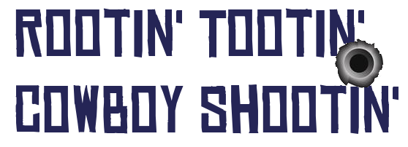
First Person Shooter.
Shooting gallery where the user shoots objects in the scene.
When the user shoots all the object they advance to the next level

Slide 3
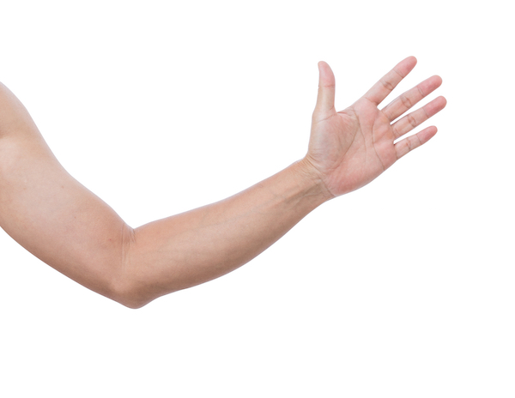
Gestures
Camera is controlled by moving your arm.

Slide 4

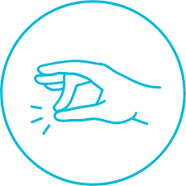
Gestures
Fist to Shoot Tap Finger to Recalibrate

Slide 5
Gestures
We decided on the arm movement gesture for aiming as it made the most sense.
Tap fingers for recalibration – easy gesture
Fist for shooting – closest gesture to pulling a trigger

Slide 6
Gestures
Plan to use more gestures - Main Menu, Pause Menu.
Gestures undecided as of yet.

Slide 7
Development
Started with setting up the scene with blank objects.
Worked on that and what mechanics to implement.
Get the movement and shooting working with mouse + keyboard
Transitioned to the myo once working.

Slide 8
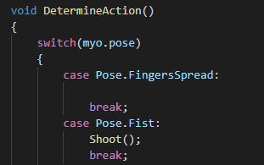
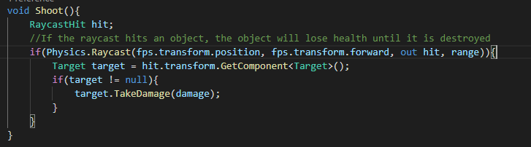
Code Example

